Slide 1
PKI Concepts

Slide 2


Online and offline CAs
Offline CA
Disconnect root CA to isolate and protect it
No certificates issued by compromised CA can be trusted
Isolation prevents malicious attacks
Load is carried by subordinate CAs

Slide 3
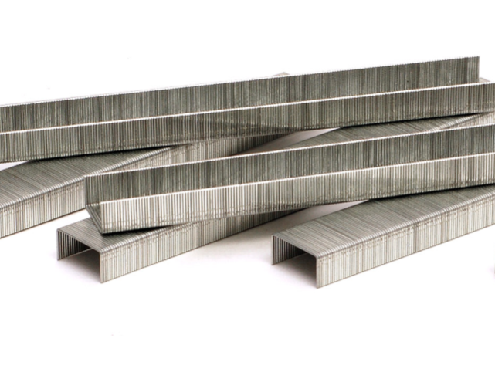
OCSP Stapling
Online Certificate Status Protocol
CA must respond to all client OCSP requests
Can overload a CA with extra traffic
Solution: Certificate owner stores OCSP response
OCSP status is “stapled” to the SSL/TLS handshake
Signed by the CA to ensure authenticity and timeliness

Slide 4

Pinning
Sending/receiving keys generates traffic
Store the key in a list
“Pin” the expected public key to an application
Built into the app’s code
Downloaded and stored on first launch
If keys do not match, application can decide how to respond
Show alert message
Stop running
Rarely used after 2017

Slide 5
PKI trust relationships
Single CA
Everyone receives their certificates from one authority

Slide 6
PKI trust relationships
Single CA
Everyone receives their certificates from one authority
Hierarchical
Single CA issues certs to intermediate CAs

Slide 7
PKI trust relationships
Mesh
CAs cross check one another
Becomes messy and burdensome as CAs get added
YUCK!

Slide 8
PKI trust relationships
Web-of-trust
Alternative to PKI
Everyone is trusted “CA”
All members trust and check each other
Some technologies use this
Blockchain
PGP

Slide 9
PKI trust relationships
Mutual Authentication
Server authenticates to the client and the client authenticates to the server

Slide 10

Key escrow
Outside organization holds decryption keys
Offloads risk of key security and storage to third party
Important to define how to gain access to keys when necessary

Slide 11
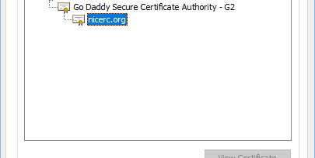
Certificate chaining
Chain of trust
Lists all certs between server and root CA
Any certificate between SSL and root is a chain certificate
If chain is unclear, user may get security warning
Chain starts with SSL certificate
Traces back to root CA

